Slide 1
Hijacking Bitcoin:
Attacks on Cryptocurrencies
Maria Apostolaki, Aviv Zohar, Laurent Vanbever
2017 IEEE Symposium on Security and Privacy (SP)
PRESENTED BY 陳廷易
2018/06/04
Notes:
今天我想介紹一些與網絡相關的安全問題。
比特幣是基於P2P系統的，並且由於P2P系統是基於因特網的，當出現與互聯網相關的問題時會出現各種問題。
本文通過將BGP協議中的問題應用於比特幣網絡來分析比特幣系統
將這個BGP劫持應用到比特幣網絡

Slide 2
CONTENTS
01
Background and Introduction
02
Partition Attack
03
Delay Attack
04
Defense and Countermeasure

Slide 3
1
点击此处添加标题
TITLE HERE
标题数字等都可以通过点击和重新输入进行更改，顶部“开始”面板中可以对字体、字号、颜色、行距等进行修改。
1
Background and
Introduction
AS、BGP、Bitcoin

Slide 4
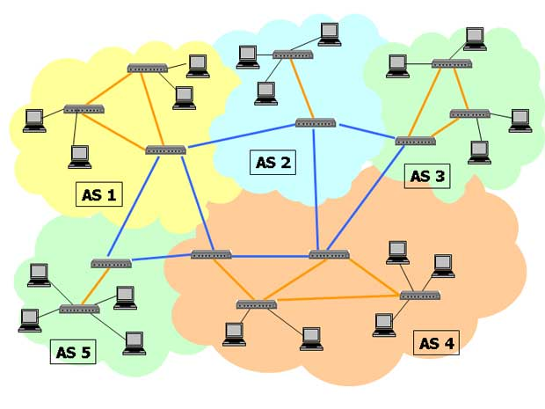

Autonomous System(AS): Set of IPs under the control of one or more operator on behalf of a single administrative entity.
Background
Notes:
在一個或多個網絡運營商的控制下代表單個管理實體或域的互聯網協議
圖中的藍線和黃線，藍線是用於AS之間通信的通信通道，黃線是用於AS內通信的通信通道。簡而言之，您可以將黃線視為城市公交車和藍線作為城際公交車。這是在AS內通信時使用的協議
每個AS(自治區)由不同組織所管理

Slide 5
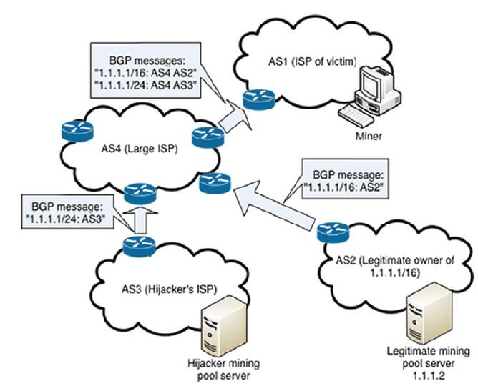
Border Gateway Protocol (BGP): Protocol used to exchange routing and reachability information among AS on the internet.
Background
Notes:
規定了IP數據包在Internet上的轉發方式。 與不同IP前綴相關的路由在相鄰網絡或自治系統（AS）之間交換。 對於任何給定的IP前綴，一個AS（起源）負責原始路由通告，然後以AS-AS方式傳播，直到所有AS了解它
BGP是一種distance vector路由算法，它將最小距離成本信息存儲在稱為距離表的數據結構中

Slide 6
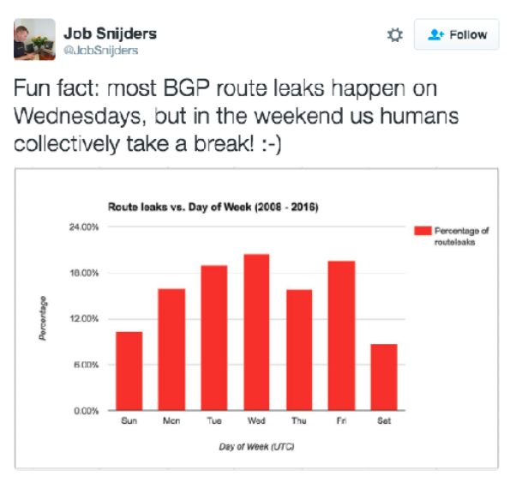
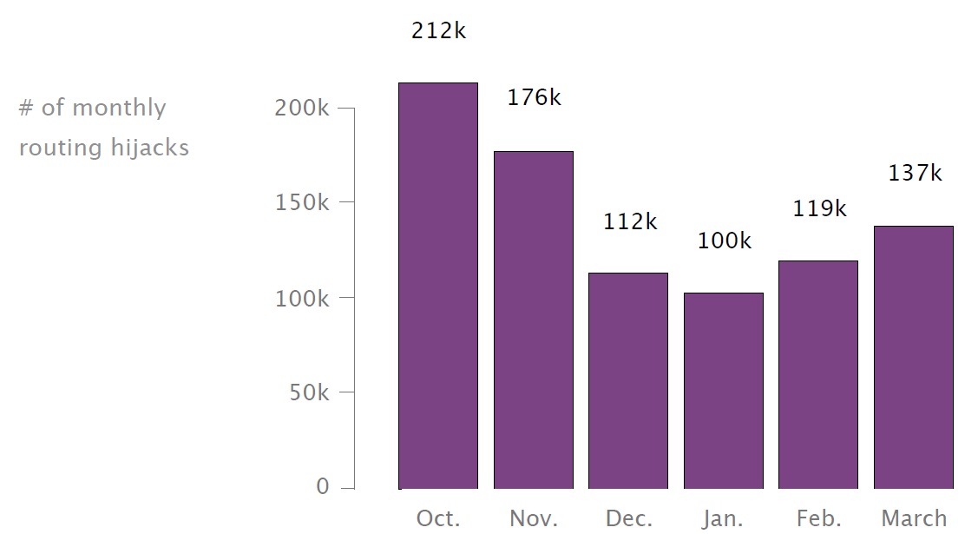
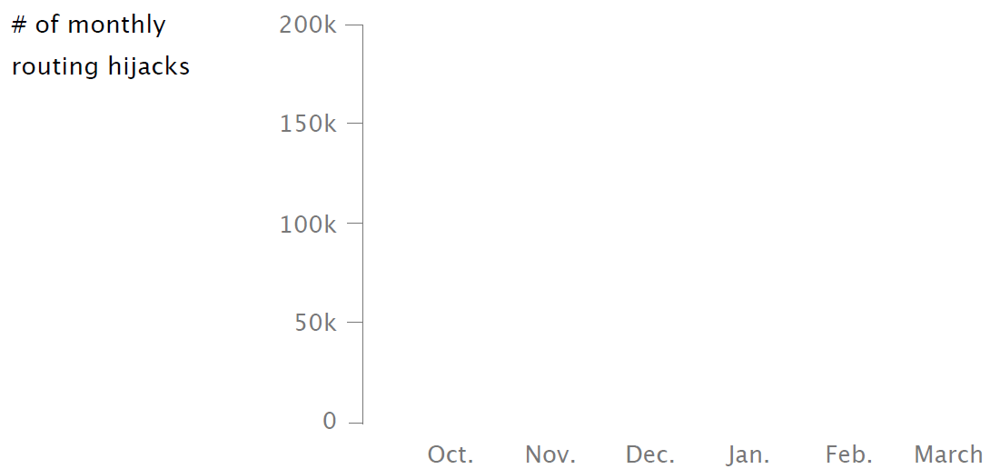
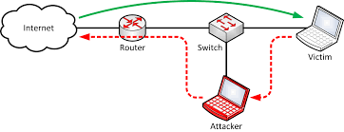
Routing Hijacks
Routed in clear text without integrity check.
Both node level and network wide attacks are were considered.
Partitioning attack to disconnect a set of nodes form the network.
Delay attack to slow down the propagation of blocks towards or from a given set of nodes.
Notes:
As Bitcoin connections are routed over the Internet— in clear text and without integrity checks—any third-party on the forwarding path can eavesdrop, drop, modify, inject,
or delay Bitcoin messages such as blocks or transactions. Detecting such attackers is challenging as it requires inferring the exact forwarding paths taken by the Bitcoin traffic
using measurements.
Both node-level attacks along with more challenging, but also more disruptive, network-wide attacks are considered.
Impact: node waste, blocks discarded and filter transactions. Miners lose potential revenue.

Slide 7

About Bitcoin
Scatter all around the globe.
Establish random connections.
Use multihoming and extra relay networks.
In principle, Bitcoin should be highly decentralized making it robust to routing attacks.
Bitcoin nodes should……
Notes:
Bitcoin is a worldwide cryptocurrency and digital payment system called the first decentralized digital currency, as the system works without a central repository or single administrator. Bitcoins are created as a reward for mining. They can be exchanged for other currencies, products, and services. Created as rewards for mining.

Slide 8
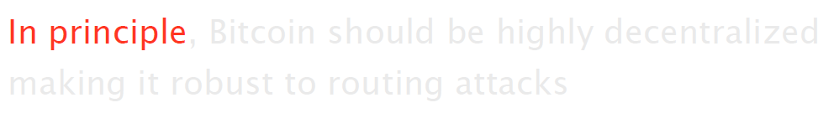
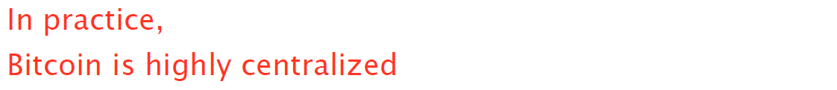
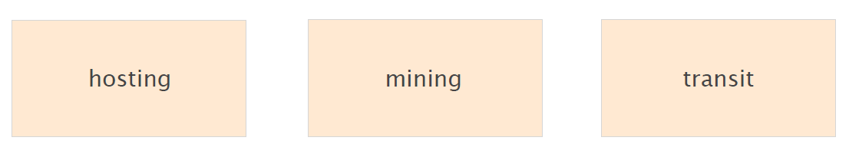
About Bitcoin
In principle, Bitcoin should be highly decentralized making it robust to routing attacks.
Notes:
可以從三個面向來述說

Slide 9
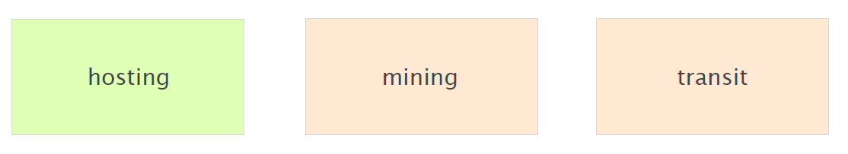
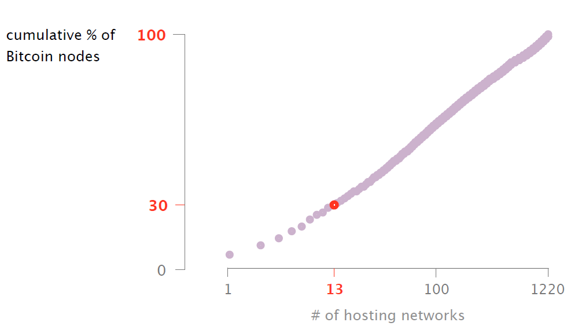
About Bitcoin
Notes:
13 networks就擁有了約 30% 的節點

Slide 10
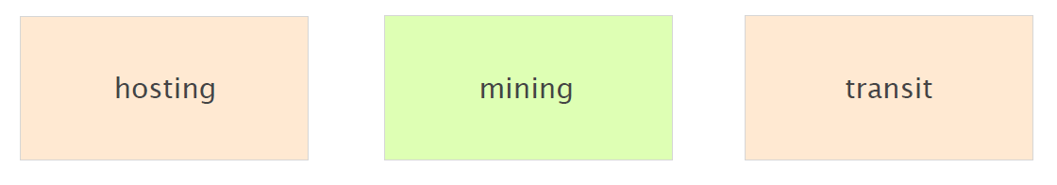
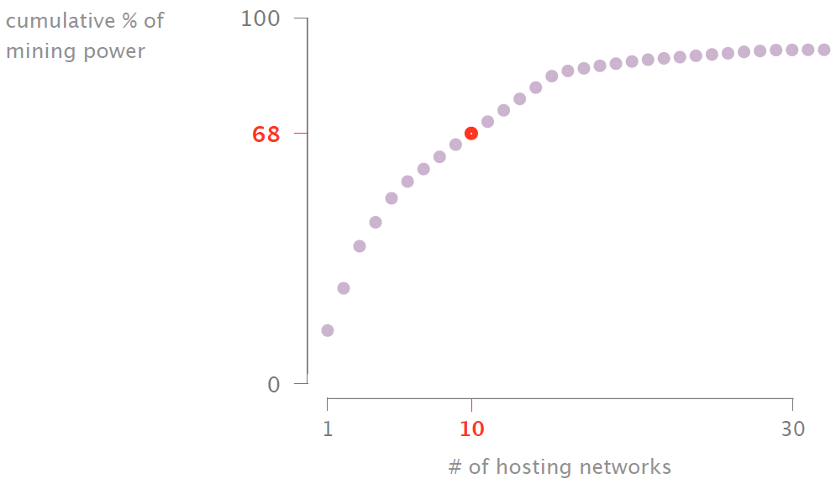
About Bitcoin
Notes:
有68% 的算力僅在10 networks only中進行

Slide 11
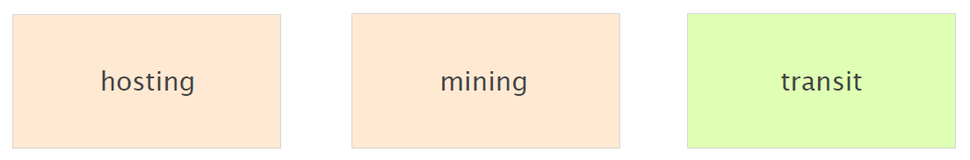
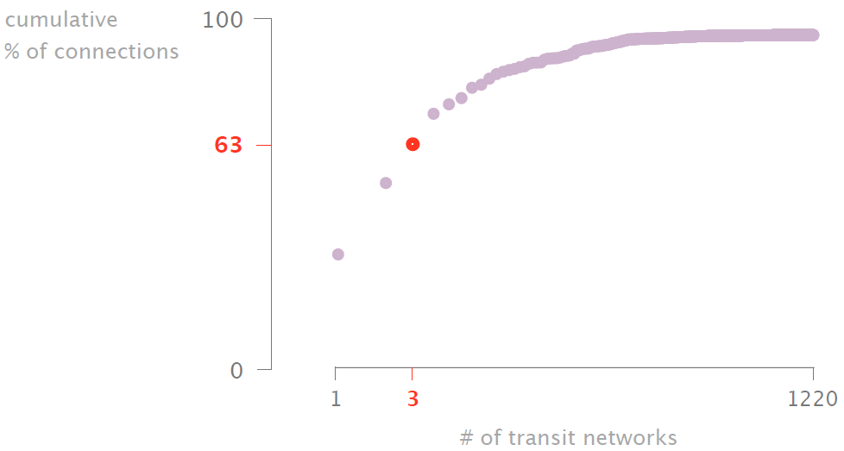
About Bitcoin
Notes:
三個轉接骨幹網絡就可以看到超過約60%的bitcoin連線

Slide 12
2
Partition Attack
分割攻擊

Slide 13
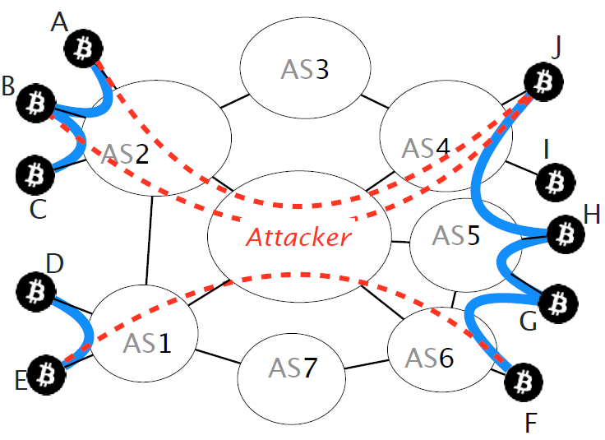
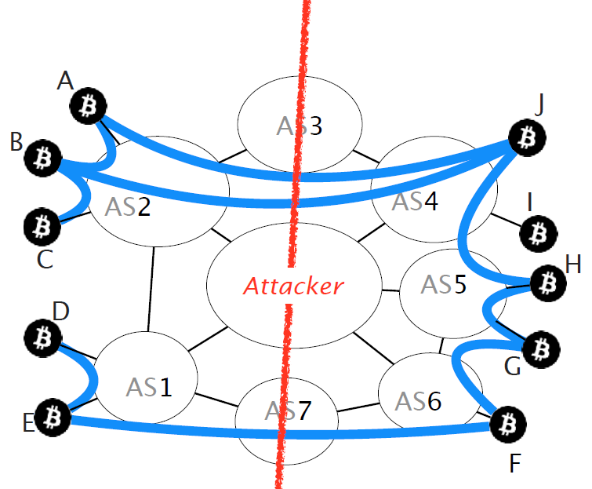
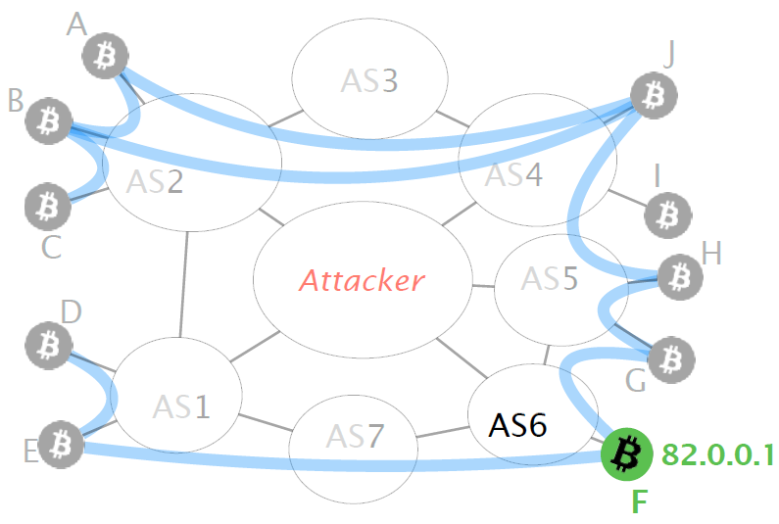
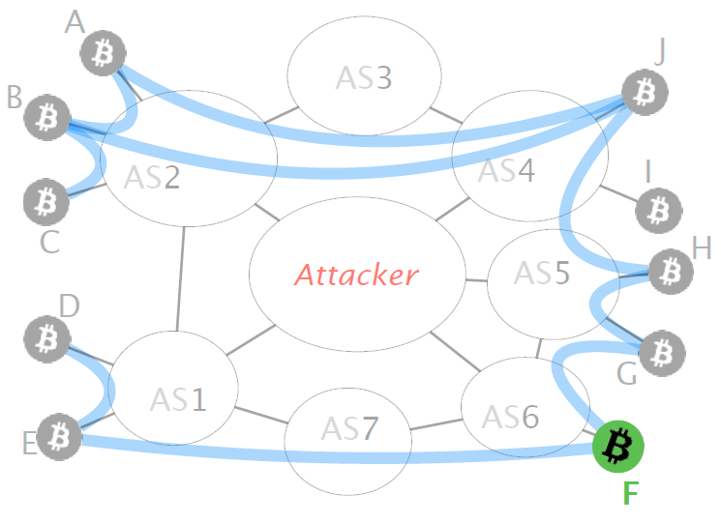
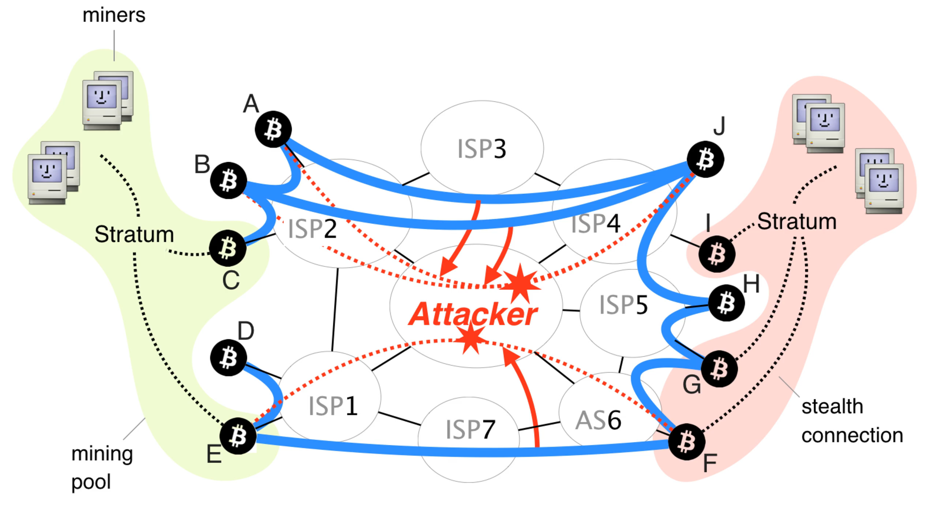
Partitioning Attack
Goal: Split the Bitcoin network into two disjoint components.
Notes:
Goal: 將部分節點孤立、分割
假設我們今天要切分左右兩塊，
假設attacke是中間的其中一個AS，
那我們先已右下角的F結點為例，
假設F節點的IP是82.0.0.1，
Vulnerable connections: A connection is vulnerable if: (i) an attacker can divert it via a BGP hijack; and (ii) it uses the Bitcoin protocol.
Stealth connections: A connection is stealth if the attacker cannot intercept it. We distinguish three types of stealth connections: (i) intra-AS; (ii) intra-pool; and (iii) pool-to-pool.
intra-AS: An attacker cannot intercept connections within the same AS using BGP hijack. Indeed, internal traffic does not get routed by BGP, but by internal routing protocols
intra-pool: This is because mining pools might rely on proprietary or even encrypted protocols for internal communication.
pool-to-pool: Finally, an attacker cannot intercept (possibly encrypted) private connections, corresponding to peering agreements between mining pools. From the attacker’s point of view, these connections can be treated as intra-pool connections and the corresponding pair of pools can be considered as one larger pool.
he attacker starts by hijacking all the prefixes pertaining to the Bitcoin nodes she wants to isolate, which she splits into two packet streams: relevant and irrelevant.
The high-level goal of the algorithms is to isolate as many nodes in P as possible. To do so, the algorithms identify L, the nodes that are leakage points, and disconnect them
from the other nodes in P.
Then it is checked whether the sender of the packet is advertising information from outside of the partition and particularly if the packet contains an INV message with the hash of a block mined outside of prtn. Particularly, the attacker checks whether the packet contains an INV message with the hash of a block mined outside of P n L (or the block itself). If it does so, the sender must have a path of stealth connections to a node outside of P n L from which the block was transmitted. Thus the sender is a leakage point and is added. The actual packet is also dropped to prevent this information from spreading. To detect whether a node in P n L is a leakage point, an attacker should be able to intercept at least one of that node’s connections.

Slide 14
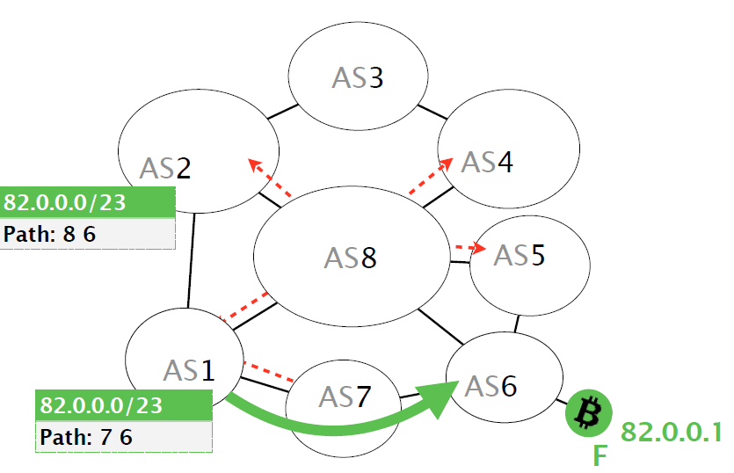
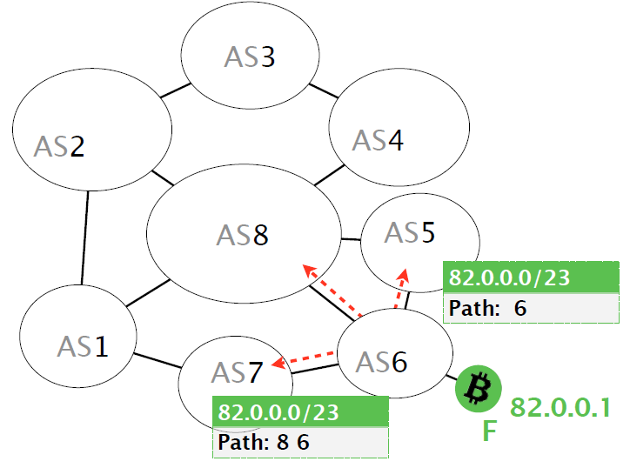
Partitioning Attack
Goal: split the Bitcoin network into two disjoint components.
Notes:
而AS6發出advertisemen說自己是82.0.0.0/23 (遮罩)
正常情況下，每個AS收到後便會依照自己最有利的方向傳輸給AS6
Vulnerable connections: A connection is vulnerable if: (i) an attacker can divert it via a BGP hijack; and (ii) it uses the Bitcoin protocol.
Stealth connections: A connection is stealth if the attacker cannot intercept it. We distinguish three types of stealth connections: (i) intra-AS; (ii) intra-pool; and (iii) pool-to-pool.
intra-AS: An attacker cannot intercept connections within the same AS using BGP hijack. Indeed, internal traffic does not get routed by BGP, but by internal routing protocols
intra-pool: This is because mining pools might rely on proprietary or even encrypted protocols for internal communication.
pool-to-pool: Finally, an attacker cannot intercept (possibly encrypted) private connections, corresponding to peering agreements between mining pools. From the attacker’s point of view, these connections can be treated as intra-pool connections and the corresponding pair of pools can be considered as one larger pool.
he attacker starts by hijacking all the prefixes pertaining to the Bitcoin nodes she wants to isolate, which she splits into two packet streams: relevant and irrelevant.
The high-level goal of the algorithms is to isolate as many nodes in P as possible. To do so, the algorithms identify L, the nodes that are leakage points, and disconnect them
from the other nodes in P.
Then it is checked whether the sender of the packet is advertising information from outside of the partition and particularly if the packet contains an INV message with the hash of a block mined outside of prtn. Particularly, the attacker checks whether the packet contains an INV message with the hash of a block mined outside of P n L (or the block itself). If it does so, the sender must have a path of stealth connections to a node outside of P n L from which the block was transmitted. Thus the sender is a leakage point and is added. The actual packet is also dropped to prevent this information from spreading. To detect whether a node in P n L is a leakage point, an attacker should be able to intercept at least one of that node’s connections.

Slide 15
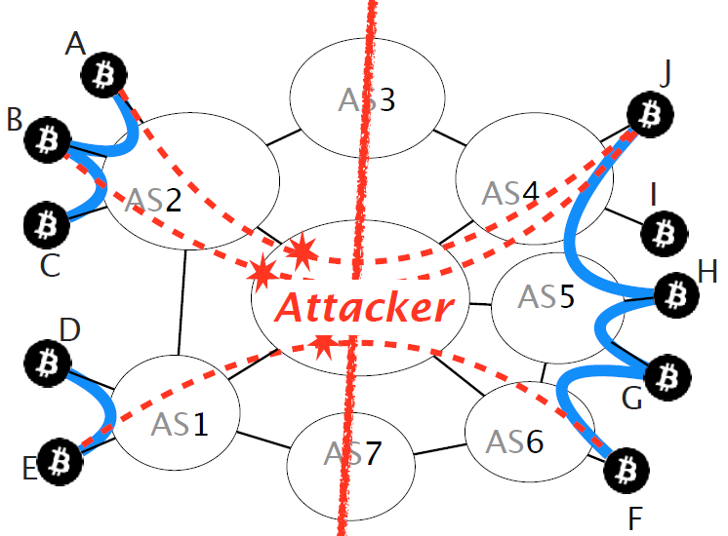
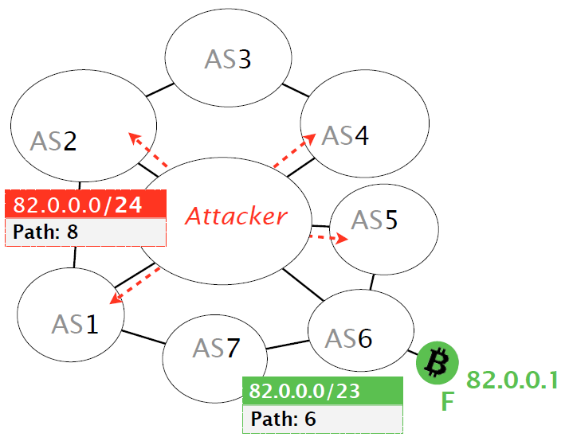
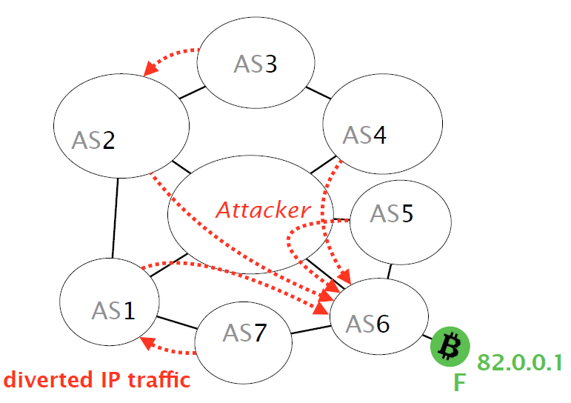
Partitioning Attack
Goal: split the Bitcoin network into two disjoint components.
Notes:
因為BGP沒有檢查advertisement的有效性，所以攻擊者就可以公布更精確得IP位址，
接下來其他AS就會認為流量應該導向attacker AS，所有到F的流量就會被hijack
攻擊者可以將所有流過來的bitcoin流量皆drop，最後就可以達到兩弟分割
Vulnerable connections: A connection is vulnerable if: (i) an attacker can divert it via a BGP hijack; and (ii) it uses the Bitcoin protocol.
Stealth connections: A connection is stealth if the attacker cannot intercept it. We distinguish three types of stealth connections: (i) intra-AS; (ii) intra-pool; and (iii) pool-to-pool.
intra-AS: An attacker cannot intercept connections within the same AS using BGP hijack. Indeed, internal traffic does not get routed by BGP, but by internal routing protocols
intra-pool: This is because mining pools might rely on proprietary or even encrypted protocols for internal communication.
pool-to-pool: Finally, an attacker cannot intercept (possibly encrypted) private connections, corresponding to peering agreements between mining pools. From the attacker’s point of view, these connections can be treated as intra-pool connections and the corresponding pair of pools can be considered as one larger pool.
he attacker starts by hijacking all the prefixes pertaining to the Bitcoin nodes she wants to isolate, which she splits into two packet streams: relevant and irrelevant.
The high-level goal of the algorithms is to isolate as many nodes in P as possible. To do so, the algorithms identify L, the nodes that are leakage points, and disconnect them
from the other nodes in P.
Then it is checked whether the sender of the packet is advertising information from outside of the partition and particularly if the packet contains an INV message with the hash of a block mined outside of prtn. Particularly, the attacker checks whether the packet contains an INV message with the hash of a block mined outside of P n L (or the block itself). If it does so, the sender must have a path of stealth connections to a node outside of P n L from which the block was transmitted. Thus the sender is a leakage point and is added. The actual packet is also dropped to prevent this information from spreading. To detect whether a node in P n L is a leakage point, an attacker should be able to intercept at least one of that node’s connections.

Slide 16
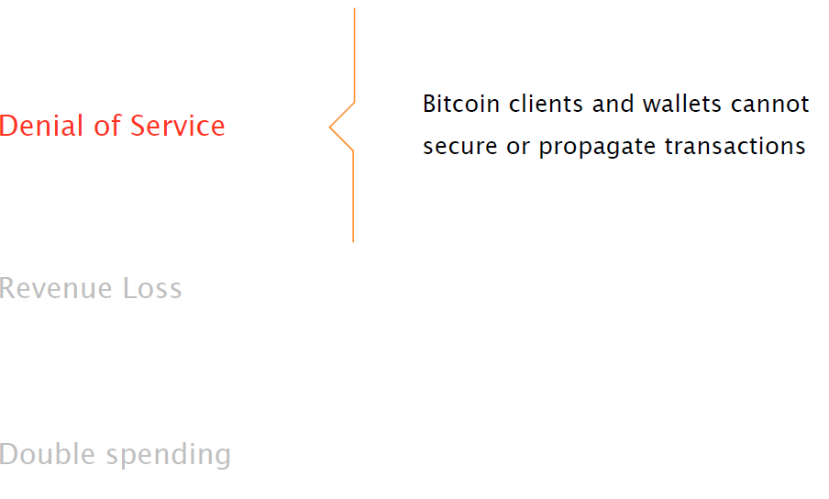
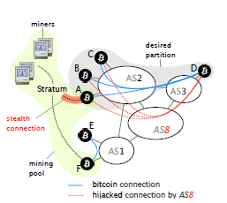
Partitioning Attack
Findings:
Less than 2 minutes to divert traffic.
Hijacking 39 prefixes enough to isolate 50% of overall mining power.
Partitions do not last longer after the attack stops.
Notes:
那麼它會造成甚麼影響呢
First, we performed a real BGP hijack against our own Bitcoin nodes and show that it takes less than 2 minutes for an attacker to divert Bitcoin traffic. Second, we estimated the number of prefixes to hijack so as to isolate nodes with a given amount of mining power. Third, we show that, while effective, partitions do not last long after the attack stops: the two components of the partition quickly reconnect, owing to natural churn. Yet, it takes hours for the two components to be densely connected again.
Impact
Depends on the number of nodes isolated.
Isolating few nodes -> Double spending.
For side with least mining power, transactions will be discarded.
Side with most mining power would cause revenue loss for the other side with risk of double spends.

Slide 17
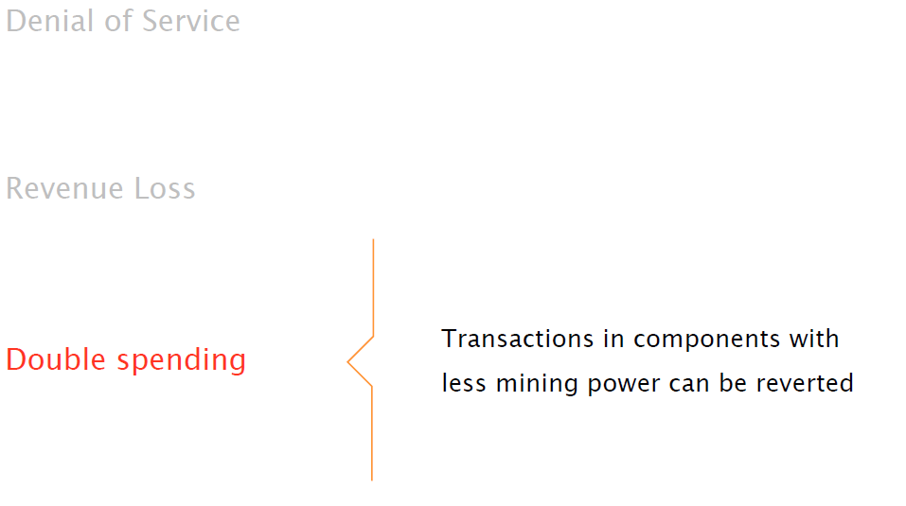
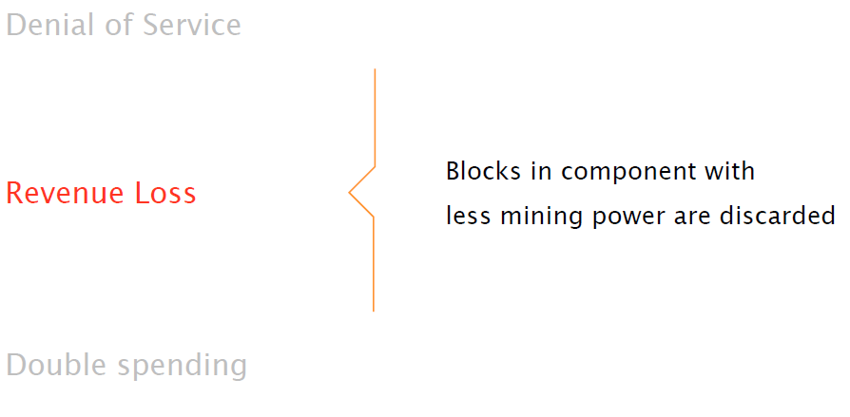
Partitioning Attack
Findings:
Less than 2 minutes to divert traffic.
Hijacking 39 prefixes enough to isolate 50% of overall mining power.
Partitions do not last longer after the attack stops.
Notes:
2.對於採礦能力最低的一方，交易將被丟棄
3.擁有大部分採礦能力的一方會為另一方帶來收入損失，並有雙重風險。
=
First, we performed a real BGP hijack against our own Bitcoin nodes and show that it takes less than 2 minutes for an attacker to divert Bitcoin traffic. Second, we estimated the number of prefixes to hijack so as to isolate nodes with a given amount of mining power. Third, we show that, while effective, partitions do not last long after the attack stops: the two components of the partition quickly reconnect, owing to natural churn. Yet, it takes hours for the two components to be densely connected again.
Impact
Depends on the number of nodes isolated.
Isolating few nodes -> Double spending.
For side with least mining power, transactions will be discarded.
Side with most mining power would cause revenue loss for the other side with risk of double spends.

Slide 18
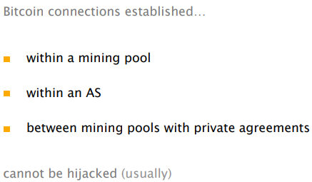
Limitations

Slide 19
3
Delay Attack
延遲攻擊

Slide 20
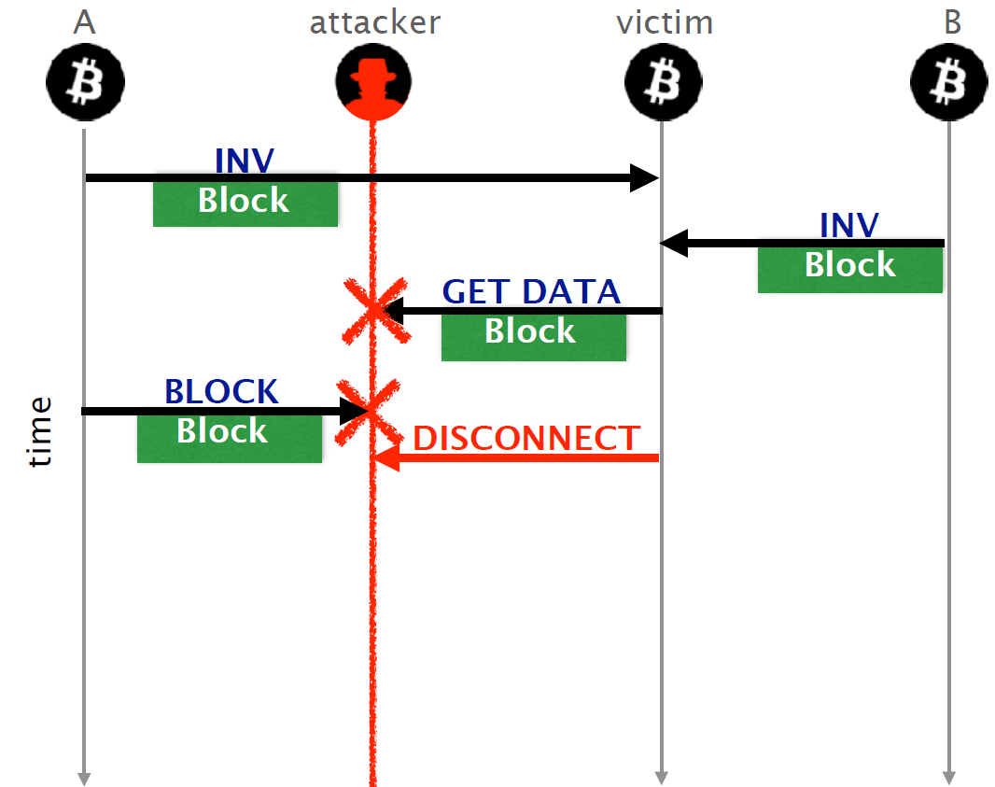
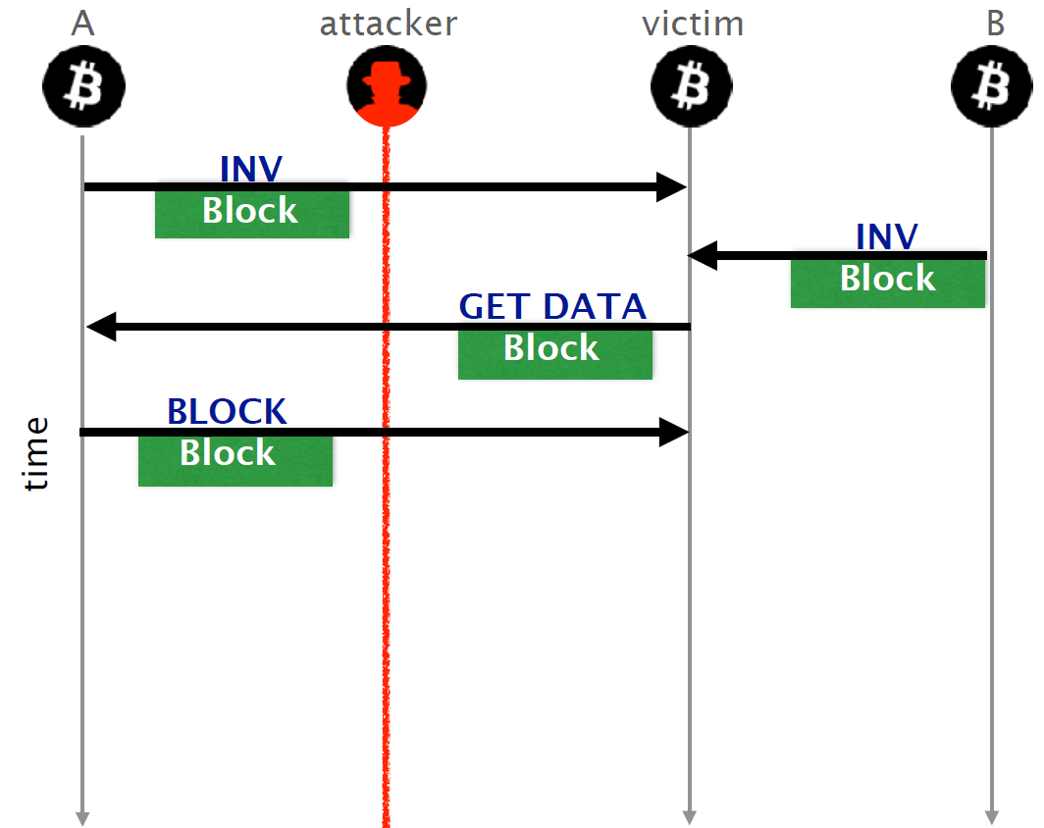
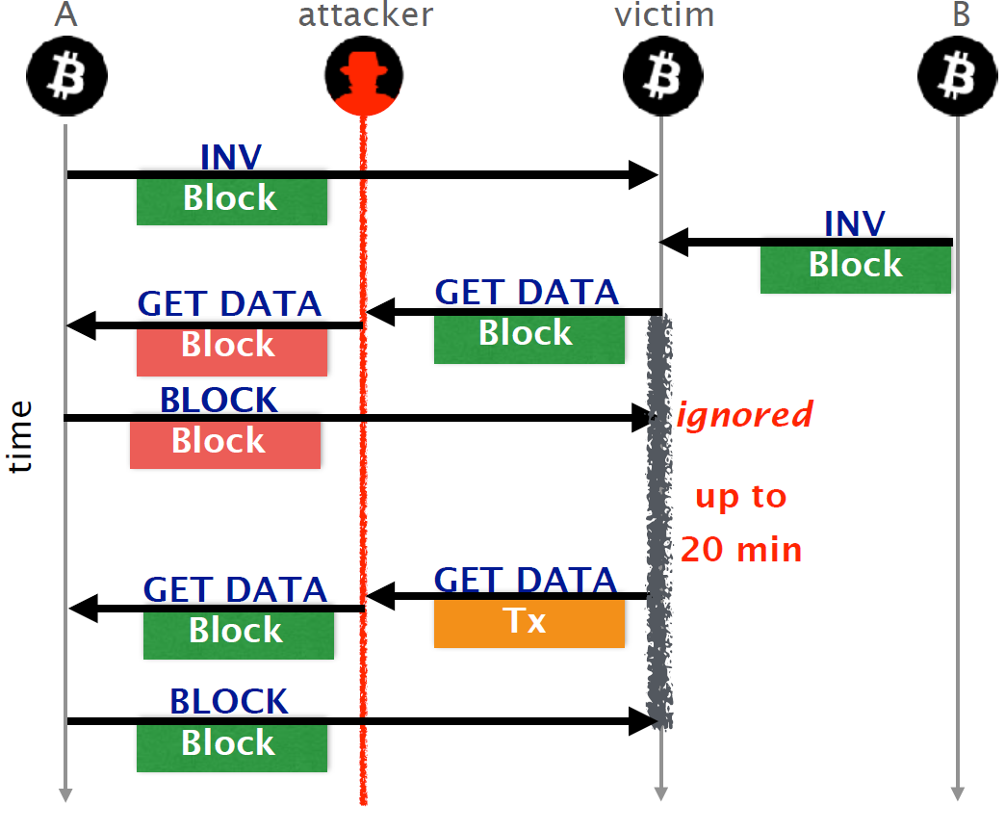
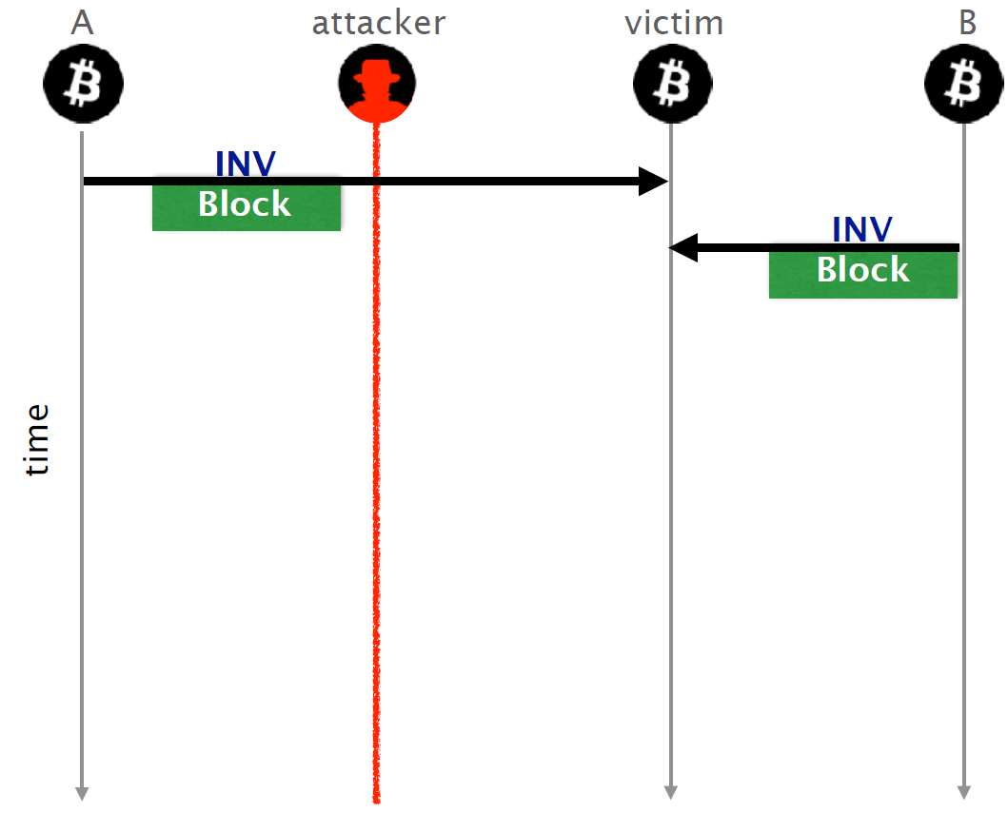
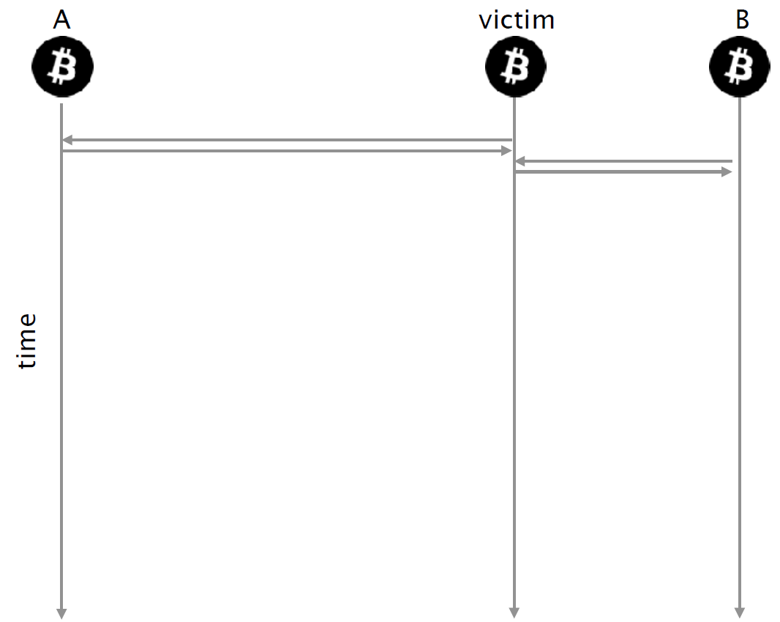
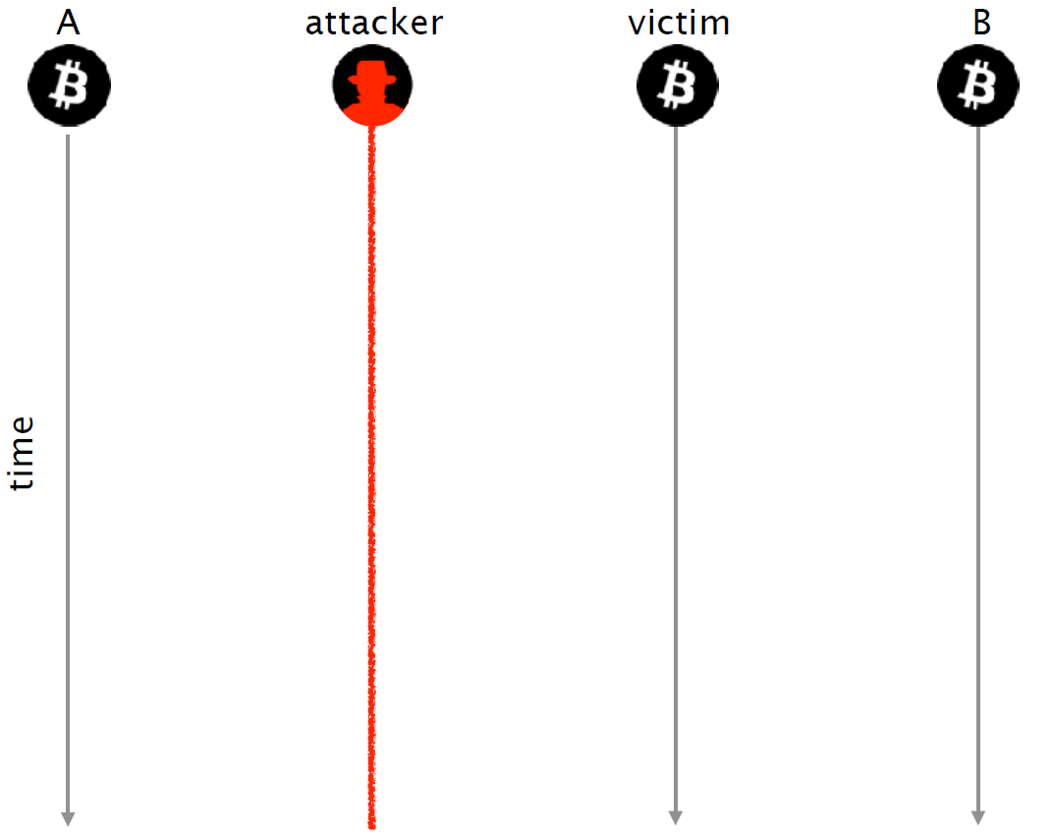
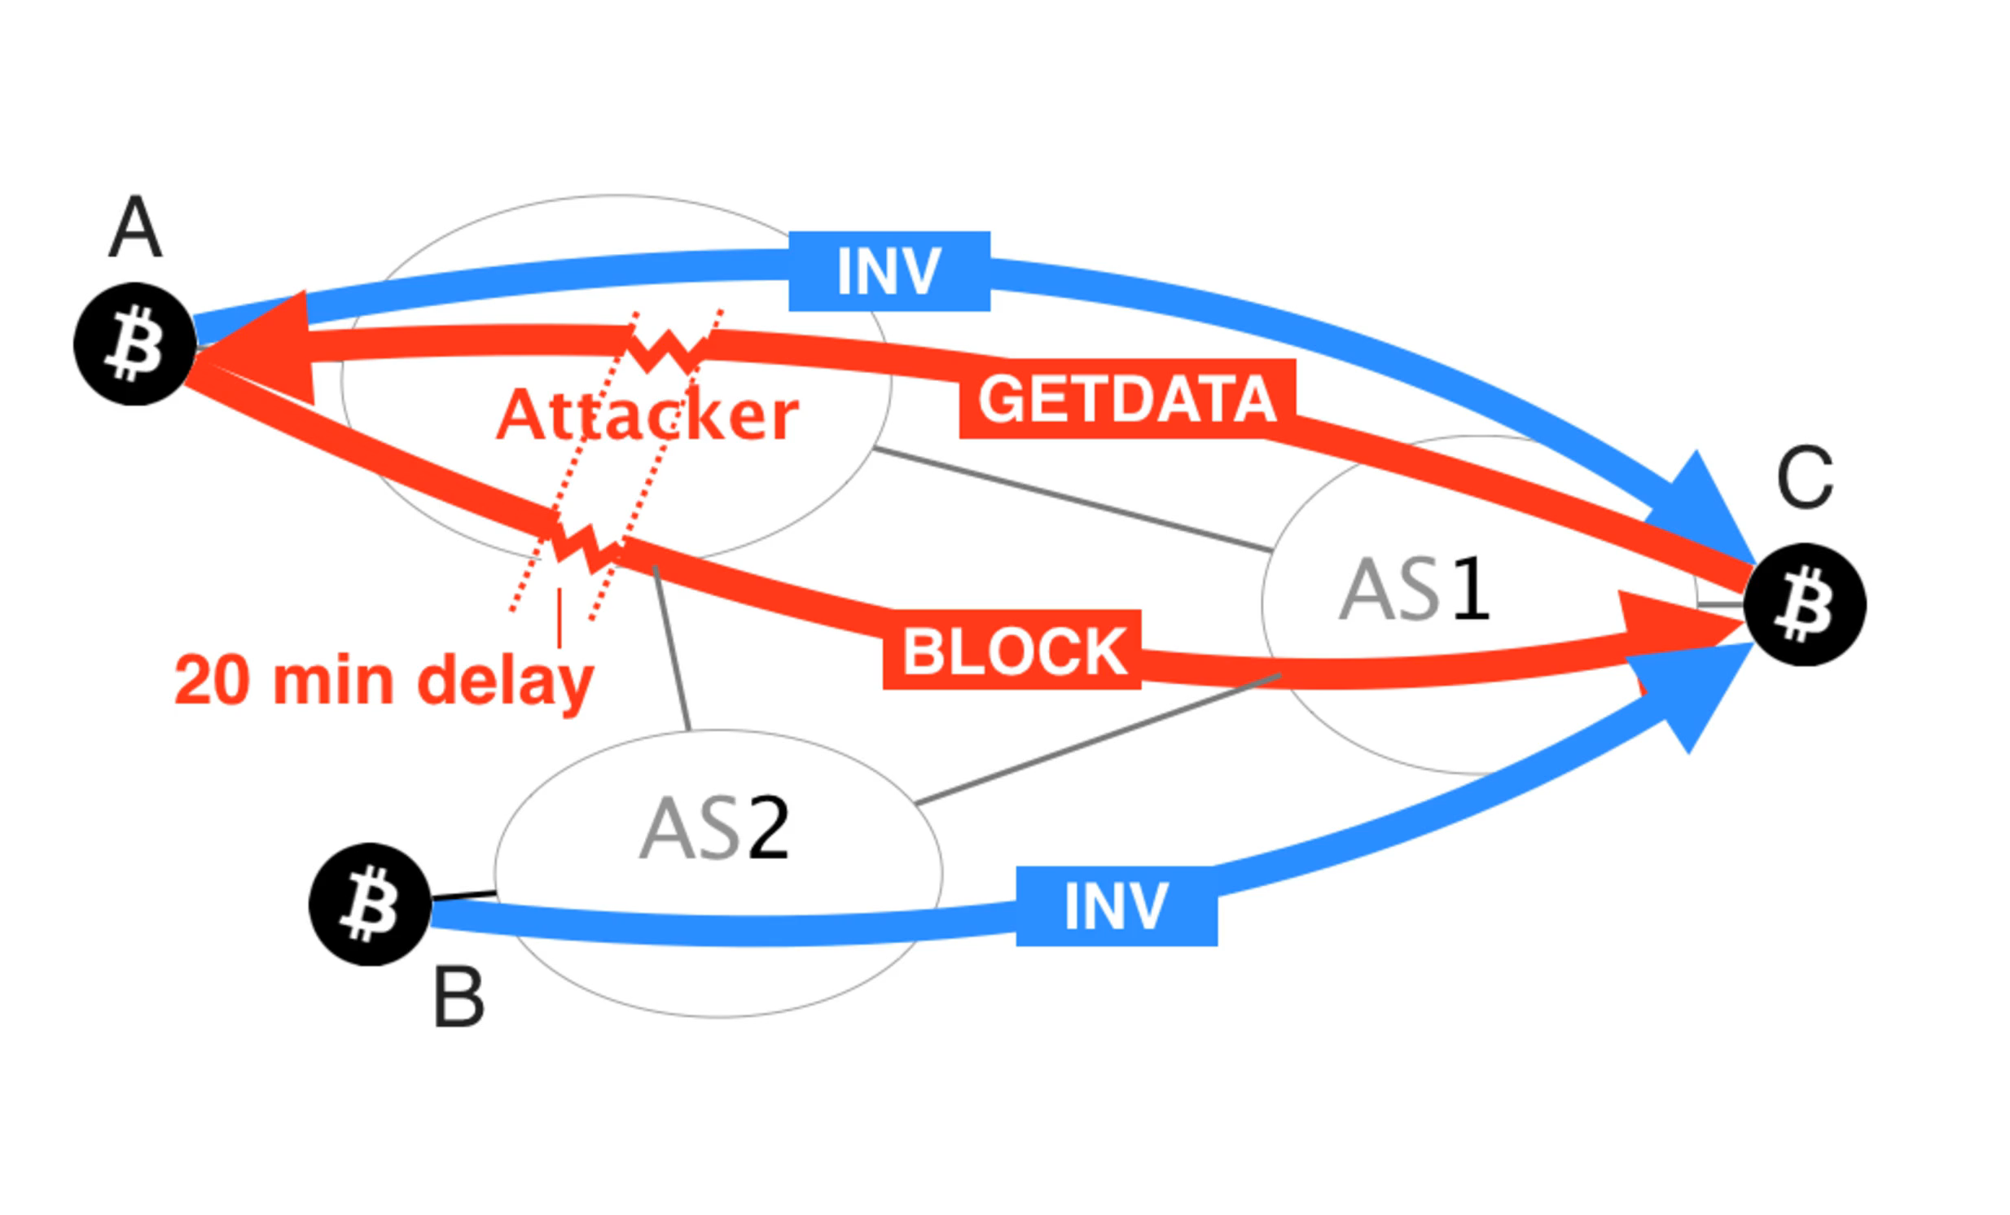
Delay Attack
Goal: keep the victim uninformed of the latest Block.
Notes:
Goal:減慢發送到一組比特幣節點的新塊的傳播而不中斷它們的連接
首先我們假設有三個節點，
現在多增加一個攻擊者在中間，
當原有節點偵測到有新節點，會發出INV訊息給他
新節點收到iNV以後，會對INV節點發出getblock 請求，然後再回傳回來
現在攻擊者可以擷取中間的bloack data，因為不會檢查訊息是否被修改過。所以攻擊者可以block或是修改
drop的話就會令victim不斷等block內容，如果是修改的話也可以讓victim等待正確的20分鐘，為了不要被斷線所以還是要給他對的
we explore delay attacks, which can cause relatively severe delays in block propagation, even when an attacker intercepts only one of the victim’s connections, and wishes the attack to remain relatively undetectable.
the adversary delays the delivery of a block by modifying the content of specific messages. This is possible due to the lack of encryption and of secure integrity checks of
Bitcoin messages.
In contrast, network-based delay attacks are more effective for at least three reasons: (i) an attacker can act on existing connections, namely she does not need to connect to the victim which is very often not possible (e.g, nodes behind a NAT); (ii) an attacker does not have to be informed about recently mined blocks by the victim’s peers to eclipse it; and (iii) the connection that was used for the attack is not necessarily lost, prolonging the attack.
Intercepts outgoing traffic, intercepts incoming traffic.
node receives a notification that a new block is available via an INV message, it issues a download request to its sender using a GETDATA message.
If the block is not delivered, the victim node will disconnect after 20 minutes. To avoid a disconnection, the attacker can use another GETDATA, sent within the 20 minute window, to perform the reverse operation. Specifically, she modifies the hash back to the original one, requested by the victim.
she can see messages received by the victim, but not the messages that it sends. This attack is less effective compared to the attack working in the opposite direction, as it will eventually result in the connection being dropped 20 minutes after the first delayed block
A naïve attack would be for the attacker to simply drop any BLOCK message she sees. A better, yet still simple approach is for the attacker to corrupt the contents of
a BLOCK message while preserving the length of the packet
Surprisingly though, we discovered (and verified) that the victim will not request the block again, be it from the same or any other peer. After the 20 minute timeout elapses,
the victim simply disconnects because its requested block did not arrive on time.
Attack leverages the 3 key aspects:
The asymmetry in the way Bitcoin nodes exchange blocks using INV, GETDATA, and BLOCK messages.
Messages are not protected against tampering.
Bitcoin node waits for 20 minutes after having requested a block from a peer before requesting it again from another peer.
If the traffic from victim is intercepted, GETDATA can be modified, but the length and the structure are preserved.
If the traffic is towards the node, the contents of the BLOCK message can be corrupted.
In both cases, the recipient remains uninformed for 20 minutes.

Slide 21
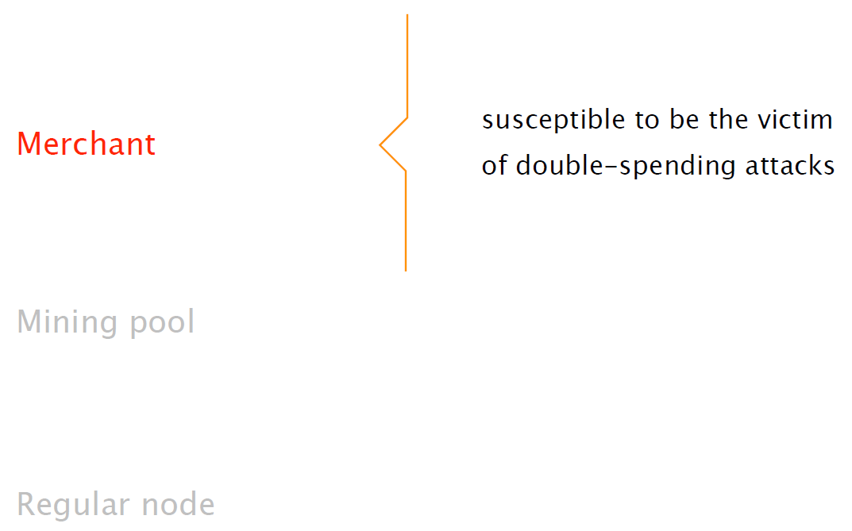
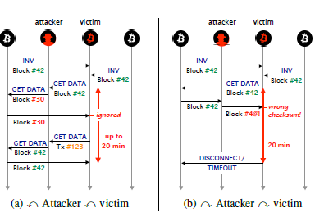
Delay Attack
Findings
Intercepting 50% of node is enough to keep node uninformed for 63% of its uptime.
Only very powerful coalitions of network attackers could perform a network-wide delay attack. Such an attack is thus unlikely to occur in practice.
Notes:
rather than acting as a normal miner and publishing blocks to the network immediately upon finding them, the attacker selectively publishes blocks, sometimes sacrificing his own revenue but also often publishing many blocks all at once and thus forcing the rest of the network to discard blocks and lose revenue.
增加了分岔速率，並使網絡容易受到其他攻擊。
Impact
At the node-level, delay attacks can keep the victim eclipsed.
Network-wide attacks increase the fork rate and render the network vulnerable to other exploits.
A slowdown of block transmission can be used to launch selfish mining attacks by adversaries with mining power.

Slide 22
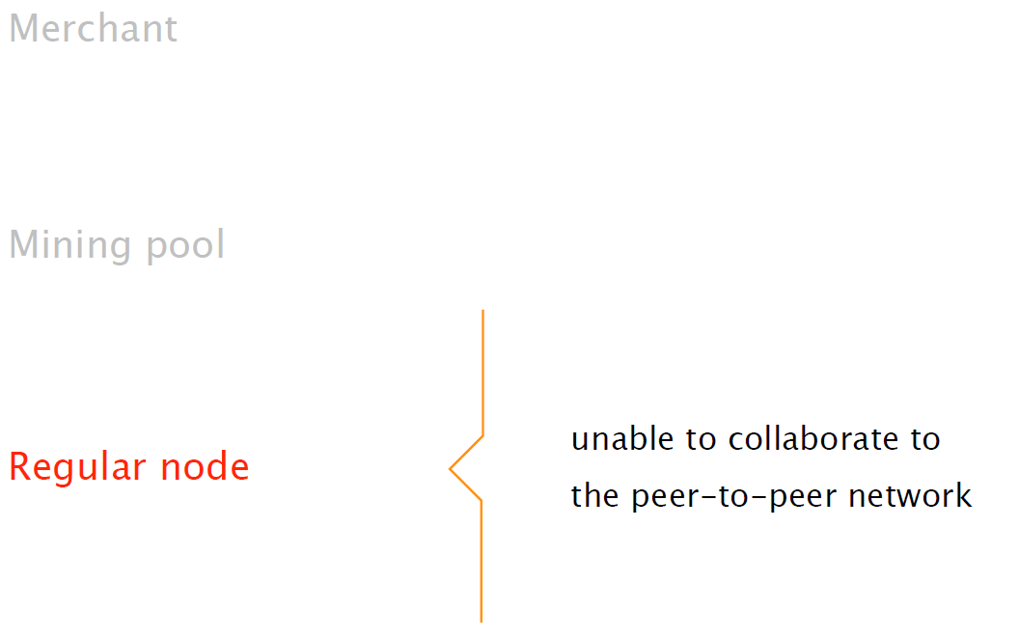
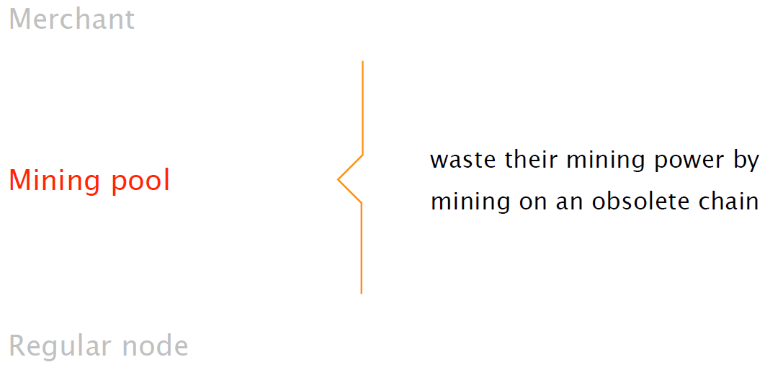
Delay Attack
Findings
Intercepting 50% of node is enough to keep node uninformed for 63% of its uptime.
Only very powerful coalitions of network attackers could perform a network-wide delay attack. Such an attack is thus unlikely to occur in practice.
Notes:
rather than acting as a normal miner and publishing blocks to the network immediately upon finding them, the attacker selectively publishes blocks, sometimes sacrificing his own revenue but also often publishing many blocks all at once and thus forcing the rest of the network to discard blocks and lose revenue.
2.發動具有採礦能力的對手的自私採礦攻擊
3.使受害者黯然失色

Slide 23
4
Defense and Countermeasures
短期、長期

Slide 24
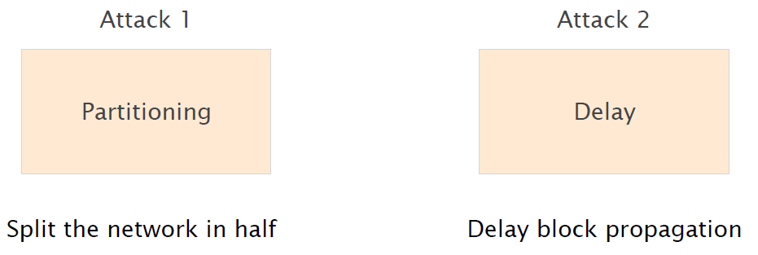

Conclusion of Attacks
Visible
Network-wide attack
Invisible
Targeted attack (set of nodes)
Notes:
attack2 不太能影響整個網路

Slide 25

Shor-term Countermeasures
Increase the diversity of node connections
Select Bitcoin peers while taking routing into account
Monitor round-trip time (RTT)
Monitor additional statistics
Nodes should allow the natural churn of the
Network to refresh their connections
Use gateways in different ASes
Prefer peers hosted in the same AS and in /24 prefixes
Notes:
短期對策可以提高比特幣網絡的彈性，而且只需要透過軟體更新
可以對routing path上的nodes進行選擇
降低讓一個ISP看到所有連接的風險
監視每個節點間的行為跟統計訊息的變化
不正常的變化表示有可能是被攻擊

Slide 26

Long-term Countermeasures
Encrypt Bitcoin Communication and/or adopt MAC
Use distinct control and data channels
Use UDP heartbeats
Request a block on multiple connections
Notes:
透過heartbeat訊息，確認每個節點的狀態。Each proxy sends a heartbeat message once per second to one of its peers, which then responds with information about its local state.
長期的對策，就可能會需要更改基礎設施或協議
使用點到點的加密，可以防止delay attack
prevent delay attacks (not partition attacks)
改為使用較為安全的protocol，因為是通訊協議上的天生缺陷EX: secure-BGP(沒人使用)
可以防止partition attack

Slide 27
References
https://btc-hijack.ethz.ch
https://www.youtube.com/watch?v=4rTp37nJzGs&t=2s
https://en.wikipedia.org/wiki/Bitcoin
http://hackingdistributed.com/2017/05/01/bgp-attacks-on-btc/
https://blog.acolyer.org/2017/06/27/hijacking-bitcoin-routing-attacks-on-cryptocurrencies/
https://blog.csdn.net/qq_16775897/article/details/79750927
https://cloud.tencent.com/developer/article/1068654
http://www.8btc.com/bitcoin-attacked-internet-routing

Slide 28
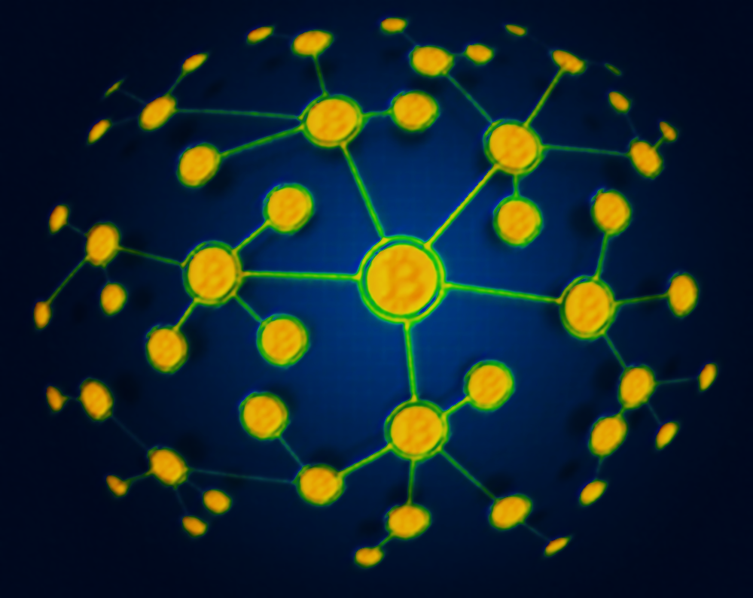
THANK YOU

